Slide 1
Flipped and Blended Learning in Context: Adapting Online Tools to Real Classroom Realities
TeachingEnglish
Teshome Bekele Sime
Saturday 16 May 2026

Slide 2
Housekeeping
1.Please be respectful at all times to other participants and the presenter. Our webinars are freely available to attend by participants in all countries. Please be aware that comments you make in the general chat may have a negative impact on other participants and their enjoyment of the webinar.
2. Do not share any personal information in the general chat that may result in other participants contacting you. This includes addresses, phone numbers and email addresses.
3. Do not share links to your website or any websites that you are promoting for the purposes of making money. Comments that include links to paid-for websites for the purpose of promotion will be deleted and you may be removed from the webinar.
4. Please use the general chat to ask the presenter questions that are related to the theme or topic of the webinar only. If participant responses to questions are permitted, you should only make comments that are relevant to the question being asked.

Slide 3
Housekeeping
5. The British Council is committed to providing a safe environment for everyone we work with so that they are able to participate to their fullest.
If you have any comments, complaints or concerns related to safety, please contact our focal point for this event/training session Michelle Thiongane at michelle.thiongane@britishcouncil.org
Alternatively, you can report any concerns, issues or complaints that you have by email, letter or telephone. Please write to Englishconnects@britishcouncil.org
These will be dealt with in the strictest confidence in line with our safeguarding policies for children and adults.

Slide 4
Pre-webinar polls
How familiar are you with Flipped learning or Blended Learning approaches?
Very familiar – I already use them regularly 1%
Somewhat familiar – I understand the idea but need more practice 0%
Not very familiar – I’ve heard about them but never tried 33%
Not familiar at all – This is new to me 66%
Which context best describes your current classroom teaching Realities?
A. Strong internet access for most students 60%
B. Limited or inconsistent internet access 20%
C. Mostly offline / low-resource environment 20%
D. Mixed access (some students online, others not) 0%

Slide 5
About the speaker
Dr Teshome Bekele is an experienced educator and researcher at Hawassa College of Teacher Education in Ethiopia. His work centers on promoting effective use of digital tools, blended learning strategies, and learner-centered methodologies, particularly in resource-limited environments.
He is passionate about promoting how technology can be adapted to local contexts to create meaningful, accessible, and sustainable learning experiences. He also actively engages in professional development networks with English Connects programmes across Sub-Saharan Africa.

Slide 6
Objectives
Understand how Flipped and Blended Learning work in context
Explain why context matters in choosing digital tools
Reflect on challenges of adapting online tools
Identify practical strategies and tools from three African case studies

Slide 7
Warmer
What comes to your mind when you think of Flipped Or Blended Learning?
Type in the chat what you think

Slide 8
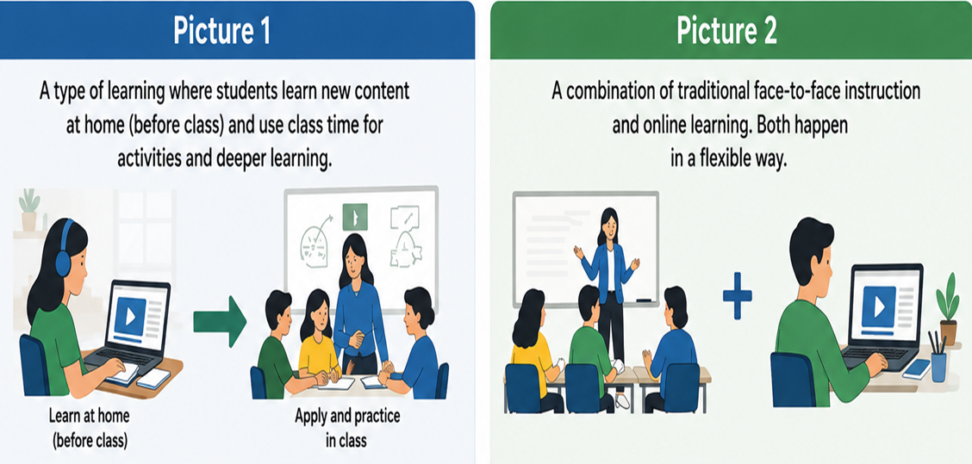
Concepts of Flipped and Blended Learning
Look at the pictures and describe what Flipped Learning mean to you. Which picture represents Flipped Learning? Which one is Blended Learning?
Please type in the chat: eg Picture 1 FL, Picture 2 FL
Image generated using ChatGPT, 2026

Slide 9
Flipped Learning Vs Blended Learning
Aspect | Flipped Learning | Blended Learning
Main idea | Reverses traditional teaching approach | face-to-face + Online(not necessarily online)
Content | Content learned at home (before class) | Learning happens both in & outside classroom
Class time | Used for practice, discussion, problem-solving, and application | for teaching, and facilitation in different modes
Online Tech | Only used if materials are shared online. | Only needed if online tools/platforms are used
Teachers role | Facilitator during class activities | Facilitator in both in-person and other learning
Student’s role | Study content before, practice in class and after class) | Highly flexible :Anytime, Anywhere & their own pace
Relationship | All Flipped Learning can be BL | A broader approach that may include FL
Advantage | Maximizes critical thinking time in class. For disabilities: repeat the material several times | Adapts to different contexts, resources and learner needs
https://www.facebook.com/TeachingEnglish.BritishCouncil/posts/what-is-flipped-learninghere-maria-and-majo-explain-what-it-is-and-how-teachers-/671042711731884/
Notes:
This table compares flipped learning and blended learning. Flipped learning always includes learning before class and active use of class time, while blended learning is a broader model that combines face‑to‑face teaching with other learning modes. Both approaches increase flexibility, but flipped learning particularly supports repetition and accessibility for diverse learners.

Slide 10
Here are examples of Flipped and Blended Learning contexts. Read each scenario and decide: Flipped (FL), Blended (BL), or Traditional (TR)
Teacher gives lecture in class, then homework after that
A teacher sends short grammar videos via WhatsApp before class →Students practice in class
A teacher gives in-person lessons + printed self-study packets
Students watch a video at home, practice in class
Students attend face-to-face lessons during the day and later submit assignments through Google Classroom. The teacher gives feedback online.
Which of these examples is Flipped , Blended or Traditional
Please type your responses eg. 1BL 1FL or TR
https://www.britishcouncil.org/voices-magazine/how-flip-classroom-using-game-based-learning

Slide 11
Simple Adaptable online Tools: Match each tool to the correct category (you may choose more than one).
A
1. High-Tech Tools
2. Mid-Tech Tools
3. Low-Tech Tools
4. Offline Tools
B
a. SMS
b. YouTube
c. WhatsApp
d. Basic Phone / Voice Recorder
e. Google Classroom
f. SD cards with video lessons
g. Zoom live class
h. Audio lessons (radio or MP3)
i. Telegram
Type in the chat. Eg. 1:a,b, 2:c,g

Slide 12
Simple Adaptable online Tools: Match each tool to the correct category (you may choose more than one).
A
1. High-Tech Tools
2. Mid-Tech Tools
3. Low-Tech Tools
4. Offline Tools
B
a. SMS
b. YouTube
c. WhatsApp
d. Basic Phone / Voice Recorder
e. Google Classroom
f. SD cards with video lessons
g. Zoom live class
h. Audio lessons (radio or MP3)
i. Telegram
Notes:
High Tech Tools: b, e, g
Mid-Tech Tools: c, i
Low-Tech Tools: h, d
Offline Tools: a, f

Slide 13
Here are Simple Adaptable Tools for Flipped/Blended Learning context
A. High-tech (Requires strong internet
+ smart devices)
YouTube ,Kahoot! / Quizizz , Google Classroom
Google Docs , Padlet , Mentimeter
B. Mid-tech (Moderate internet)
WhatsApp, PowerPoint (with voice recording)
Telegram, Google Forms
C. Low-tech (Minimal internet, or simple device use)
Kolibri, SD card, phone camera,
Phone Voice Recorder, USB drives / Bluetooth sharing
D. Offline (No internet required)
Printed notes / worksheets
SMS (basic phones)
Radio/TV broadcasts
Any more tools? Which Tools (A-D) have you applied so far? Which one will you try? Please type your answers in the chat.
https://www.britishcoun-flip-classroom-using-game-based-learning

Slide 14
How can we Adapt Online Tools? Here are some Tips
Analyse Your Teaching Context (Resources)
Define Clear Objectives (Pre-During-After)
Select Accessible Tools (easy-to-use tools)
Adapt Content for Pre-Class Learning (Flipped Phase)
Design Interactive In-Class Activities (Blended Phase)
For low-resource contexts, use low-data apps:
WhatsApp, audio recordings, downloadable materials
Provide Clear Instructions and Support
Ensure Flexibility and Inclusivity
Monitor Participation and Engagement
Provide Timely Feedback

Slide 15
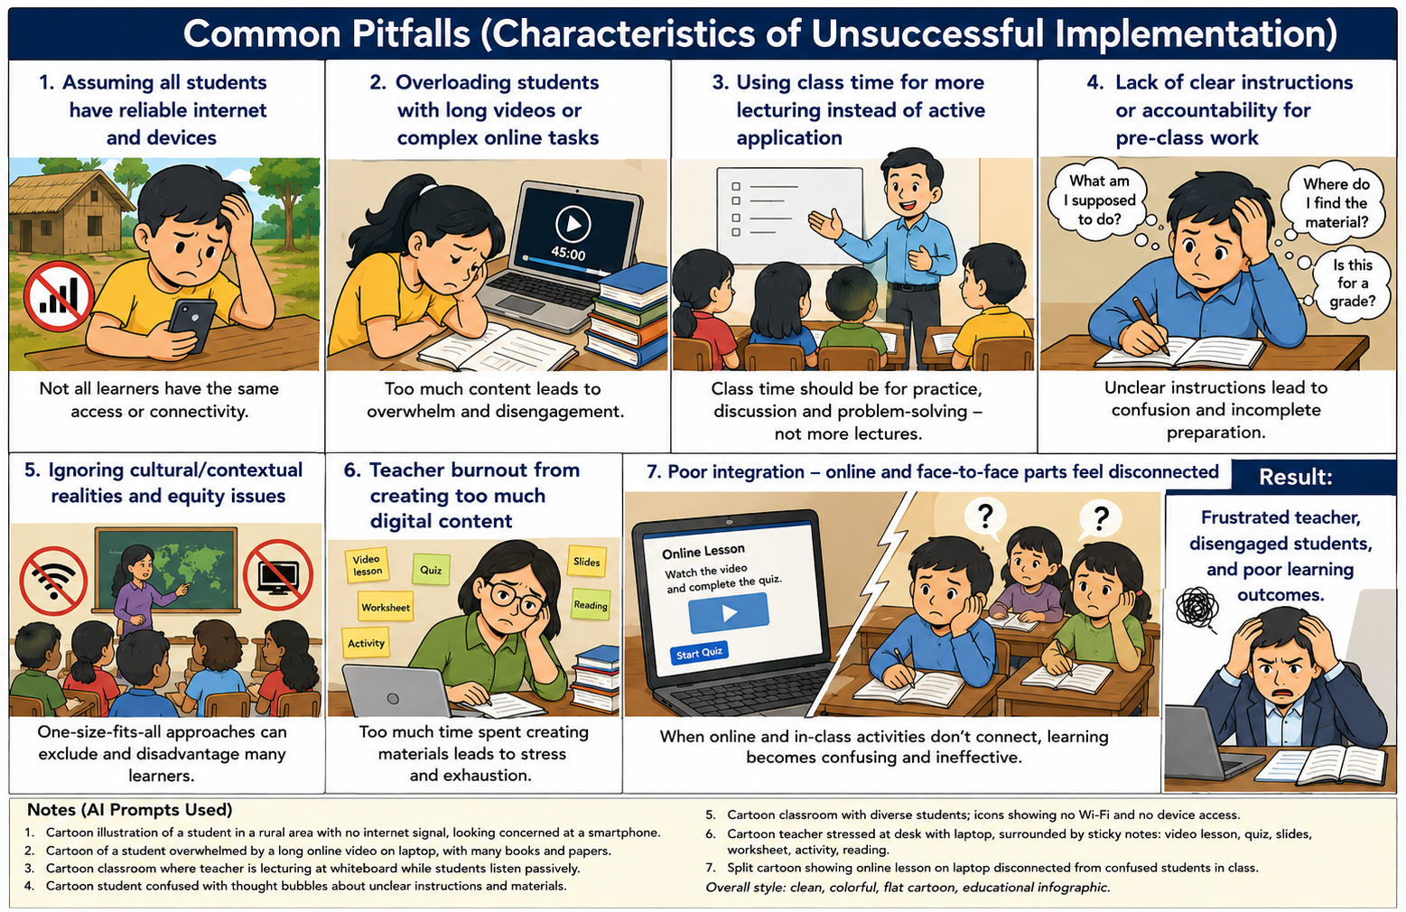
So, what might happen when both students and teachers have access to devices, but the context is not properly considered? Look at the picture!
Have you ever experienced a situation like this in your own context?
If Yes which ones ?
Type in the chat eg.1,2 or 3.
Image generated using ChatGPT (OpenAI), 2026
Notes:
AI Image Generation Prompts Used
1 Cartoon illustration of a student sitting outside a rural house with no internet signal but only phone
2 Cartoon illustration of a tired girl with Long online video & many books
3 Cartoon illustration of a teacher lecturing while students look passive
4 Cartoon illustration of a boy confused with unclear instructions
5 Cartoon illustration of a diverse students with "no Wi-fi" and "no devices"
6 Cartoon illustration of a teacher stressed creating too much digital tasks
7. Cartoon illustration of a disconnected online lesson and confused students

Slide 16
So, why does understanding your context matter in flipped and blended learning?
Not all classrooms have the same resources
Technology must fit learners’ reality
Access ≠ learning (students may have phones but limited data)
Cultural and institutional factors matter
Not all learners have: Internet, Devices , Same skills
Do you agree with these?
Which one is true for your context?
Let’s see your reflection in the chat
https://www.britishcouncil.in/blog/experimenting-flipped-learning-young-learners

Slide 17
Challenges in Flipped & Blended Learning
Poor internet or no internet
Limited or shared devices
Low digital skills
Large class sizes
Too many tools at a time
Low motivation
Key insights: Flipped and blended learning can work in many classrooms, but only when it fits the local teaching context.

Slide 18
Analyzing Case Studies: Flipped and Blended Learning
By Dohotchangana Abdoulaye Soro, Dr. Cynthia Adaeze Onuegwunwoke and Dr. Teshome Bekele Sime

Slide 19

Warmer
Have you read any of the case studies in the publication? Yes or No?
If yes, please share in the chat at least one thing you remember.

Slide 20
Case Study 1: Flipping the Classroom with Messaging (Côte d’Ivoire)
By Soro
Context:
Rural schools: 60–100 learners per class,
very few resources.
Mobile phones banned inside school but
widely owned or share one phone outside.
Introduced WhatsApp group to reach learning beyond school

Slide 21
Strategies Used
What he did:
Created WhatsApp groups via class delegates
Shared:
1. Short You tube videos (grammar, pronunciation)
2. Links-free Learning apps (Duolingo, British Council)
3. Simple text summaries (low data option)
Used Flipped Learning Approach (before class)
Which of these strategies have you tried for your context ?

Slide 22
Challenges & Solutions
Unreliable internet and expensive data→ low-data content + text summaries
New to online platforms → step-by-step guidance
Initial doubts from parents and school leaders → Communicate via meetings
Impact
Increased motivation and confidence
Collaborative learning
Better lesson preparation
Stronger acceptance
Key Insight: Simple tools like WhatsApp can enable flipped learning even with limited resources

Slide 23
Case Study 2: Balancing High-Tech & Low-Tech (Nigeria)
By Dr. Cynthia
Context:
Urban: University students (good internet access)
Rural: Low-resource learners (little/no internet)
Goal: Ensure equitable access for all learners
What Happens
Tools for Urban: WhatsApp → for collaboration & feedback ,
Google Docs → for writing practice
Google Forms → for assessments (with audio)
Used Blended Learning Approach + Flipped Learning
Tools for Rural Learners: Content pre-loaded on
Offline learning (Kolibri, SD cards), Voice recordings on SD cards
Used Phones for SMS quizzes with feedback , Community and parent support
Do you have similar experiences in your context for ensuring equitable access like Dr. Cynthia?

Slide 24
Challenges & Solutions
No internet → Offline tools (SD cards, Kolibri, SMS)
High SMS cost → Bulk SMS messaging system (low cost)
Distractions online → Structured tasks
Learning difficulties → Audio support
Impact
Improved exam pass rates
Better literacy and numeracy skills
Increased participation (even shy learners)
Significant grammar improvement
What is your challenge in your school context?

Slide 25
Case Study 3: Blended Learning for Teachers (Ethiopia)
By Dr. Teshome Bekele Sime
Context: Limited resources and weak internet
Teacher training environment
Need for flexible learning
Used Blended Learning Approach( face-to-face +online)
What happens
Used Google Classroom as main platform
Stream (announcements)
Classwork (materials)
People (grouping learners)
Grades (feedback)

Slide 26
Strategy used
• Combine face-to-face + online learning • Collaborative writing in Google Docs • Peer and teacher feedback
Impact & Benefits
Improved writing and speaking skills
Increased motivation and engagement
Strong collaboration among learners
Faster and safer feedback
Improved digital skills
Brought Equity: Greater participation (especially quieter students)

Slide 27
Challenges & Solutions
Limited access to devices → use peer support, Share device, printed materials for those without devices.
Limited internet → Download in public Wi-Fi and work offline
Low proficiency →students revisit instructions, use translation tools online
What common challenges appeared across the three case studies?
Let’s see your reflection in the chat

Slide 28
What lessons can we learn from these case studies?
Start with the Context, Not Technology
Tools must match learners’ realities (devices, internet, digital skills)
Flipped learning improves preparation and participation
Blended learning supports flexibility, inclusion, and independent learning
Even simple tools (SMS, offline apps) can create powerful impact
Equity Requires Mixing High-Tech and Low-Tech
Building trust and communication with parents and communities strengthens implementation
Let’s not flip or blend what we won’t support, and never use tools our learners cannot access.’

Slide 29
Takeaway Tips: Try out in class before Friday Telegram Discussion
1. Start with your context in mind – Pick one tool learners can actually use
2. Flip one lesson – Share a short video/text via WhatsApp or print before class
3. Blend one activity – Use Google Docs for peer feedback or SMS for quick quizzes
4. Involve others – Ask a class delegate to help or inform parents
Try these tips, join the English Connects COP and share your classroom stories this Friday!
Let’s make flipped and blended learning a seamless part of our teaching so every student can shine.

Slide 30
References
https://www.facebook.com/TeachingEnglish.BritishCouncil/posts/what-is-flipped-learninghere-maria-and-majo-explain-what-it-is-and-how-teachers-/671042711731884/
https://www.britishcouncil.org/voices-magazine/how-flip-classroom-using-game-based-learning
https://www.britishcoun-flip-classroom-using-game-based-learning
https://www.youtube.com/watch?v=yzMFdDT6FSA
https://www.britishcouncil.in/blog/experimenting-flipped-learning-young-learners
https://www.teachingenglish.org.uk/professional-development/teachers/using-digital-technologies
https://africa.teachingenglish.org.uk/education/publications-research/teaching-and-learning-with-technology-sub-saharan-africa

Slide 31
Thank you Any questions?

Slide 32
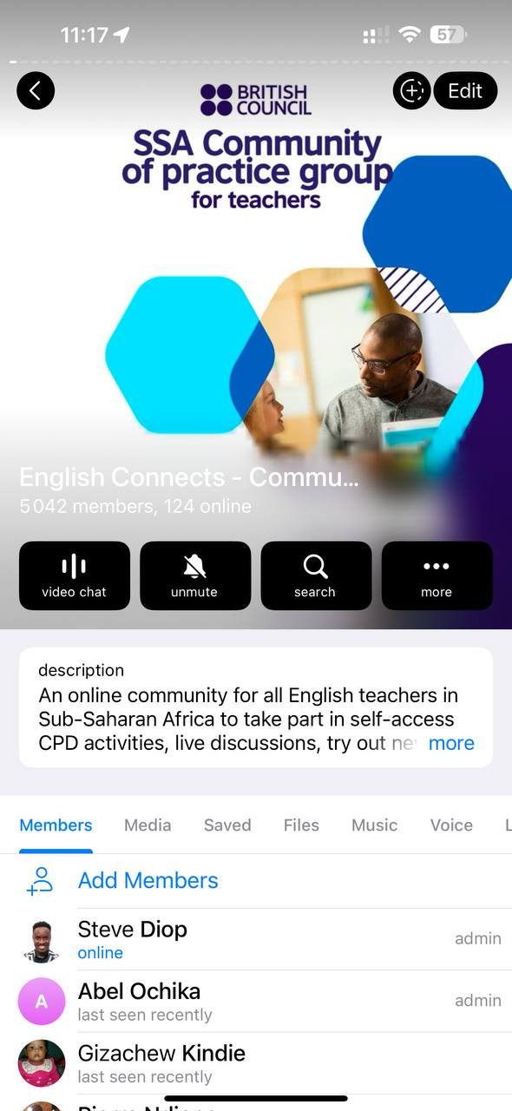
Unlock your professional growth with the English Connects Community of Practice
TeachingEnglish supports a vibrant Community of Practice connecting teachers and teacher educators across the region through the Telegram app. This group serves as a dynamic hub for sharing innovative teaching practices, exploring educational trends, and collaborating on impactful projects. Join us today: https://bit.ly/4lgZMm8

